Slide 1

Competitive Programming From Problem 2 Solution in O(1)
P
T
H
I
N
K
F
A
S
T
S
C++: Practice – Functions – Calculator V2
Mostafa Saad Ibrahim
Teaching Assistant @ Cairo University

Slide 2
Problem 1
Remember, we had some code for the calculator..all in one method.
Let’s give a check on code
All code in 1 method
Using of the goto statements
Let’s have a better one

Slide 3
Old Code Flow
We read 2 numbers
If error, repeat reading using goto
Show menu
If error, repeat menu using goto
Do operation
If divide by zero, repeat from scratch
New code will sure have same flow

Slide 4
Thinking?
We could make reading in function
When back, we have 2 numbers [repeat there]
Menu in a function
4 functions, one for each operation
One function to our Calculator
Sure the main call the calculator
Cool...

Slide 5
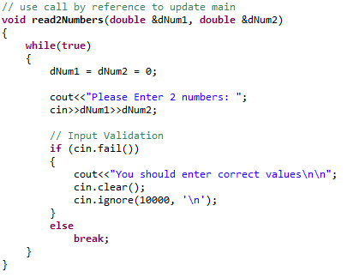
Read 2 numbers

Slide 6
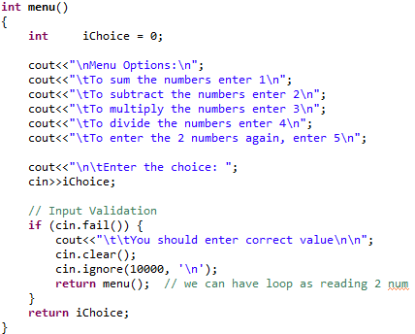
Menu

Slide 7
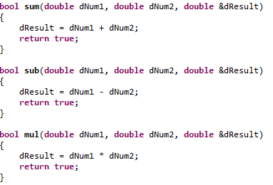
Operations

Slide 8
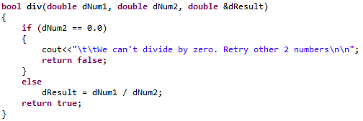
Divide

Slide 9
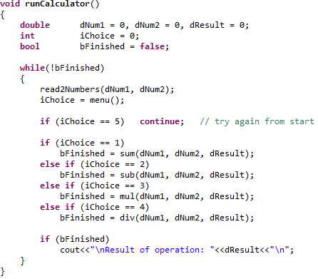
Calculator Method

Slide 10
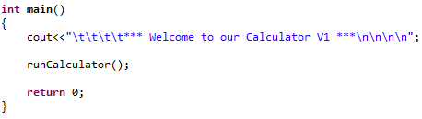
Main

